Slide 1
Exploring neighborhoods of Staten Island of New York City to open a restaurant

Slide 2
New York City (NYC), is the most populous city in the United States. With an estimated 2019 population of 8,336,817 distributed over about 302.6 square miles (784 km2), New York is also the most densely populated major city in the United States. The city is the center of the New York metropolitan area, the largest metropolitan area in the world by urban landmass. With almost 20 million people in its metropolitan statistical area and approximately 23 million in its combined statistical area, it is one of the world's most populous megacities.
Staten Island of New York City is the least populated of the 5 boroughs of New York City with an estimated population of 476,143 in 2019 but is the third-largest in land area at 58.5 sq mi (152 km2).

Slide 3
Problem
In such a large borough with least population, finding a suitable location to open a restaurant is a daunting task. In this project, we will explore neighborhoods of Staten Island and find which cuisines are popular in each neighborhood, understand its demographic trends.
This analysis can be used to find a suitable neighborhood for a restaurant. Additionally, this can also be used by a tourist travelling to Staten Island, New York City to visit neighborhoods he/she prefers or a family looking forward to move to Staten Island, New York City and could decide which neighborhood is best suited for them.

Slide 4
Data
New York City has a total of 5 boroughs and 306 neighborhoods. In order to segment the neighborhoods and explore them, we will essentially need a dataset that contains the 5 boroughs and the neighborhoods that exist in each borough as well as the latitude and longitude coordinates of each neighborhood.
New York City Department of City Planning published this data at https://geo.nyu.edu/catalog/nyu_2451_34572
Foursquare Developers Access to venue data: https://foursquare.com/developers/apps
Foursquare is a location data provider, which will be used to make RESTful API calls to retrieve data about restaurants in different neighborhoods.

Slide 5
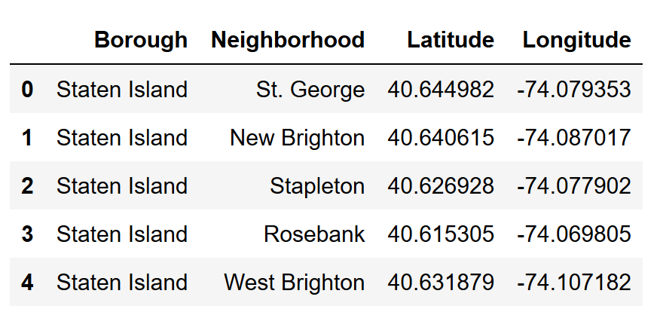
Staten Island data sample after stripping

Slide 6
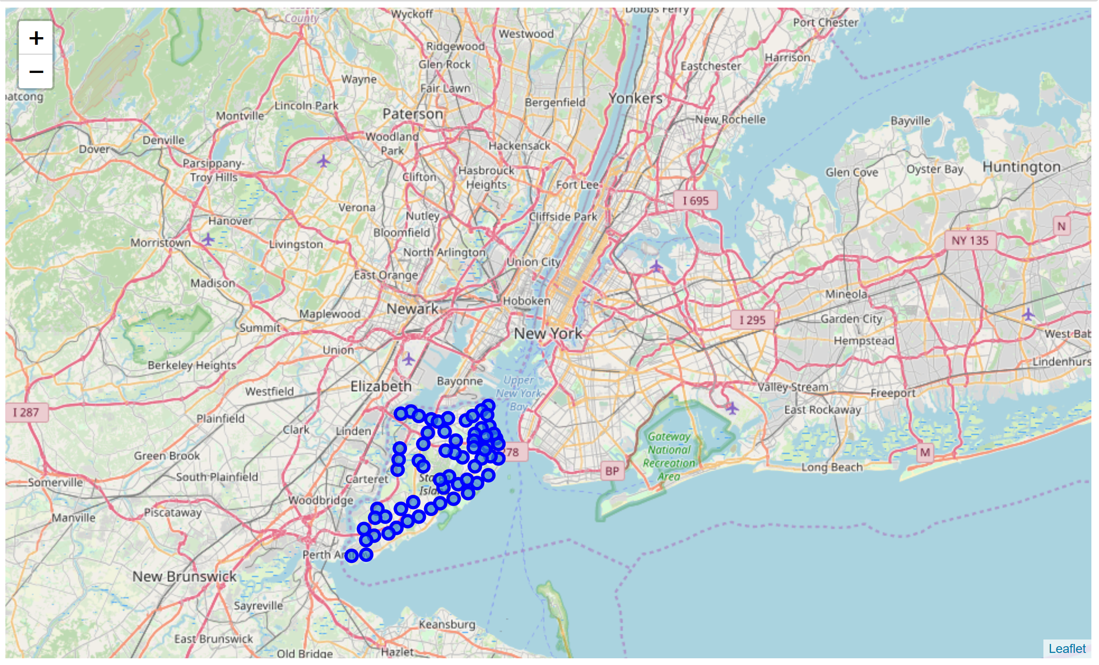
New York City with Staten Island neighborhoods superimposed on top

Slide 7
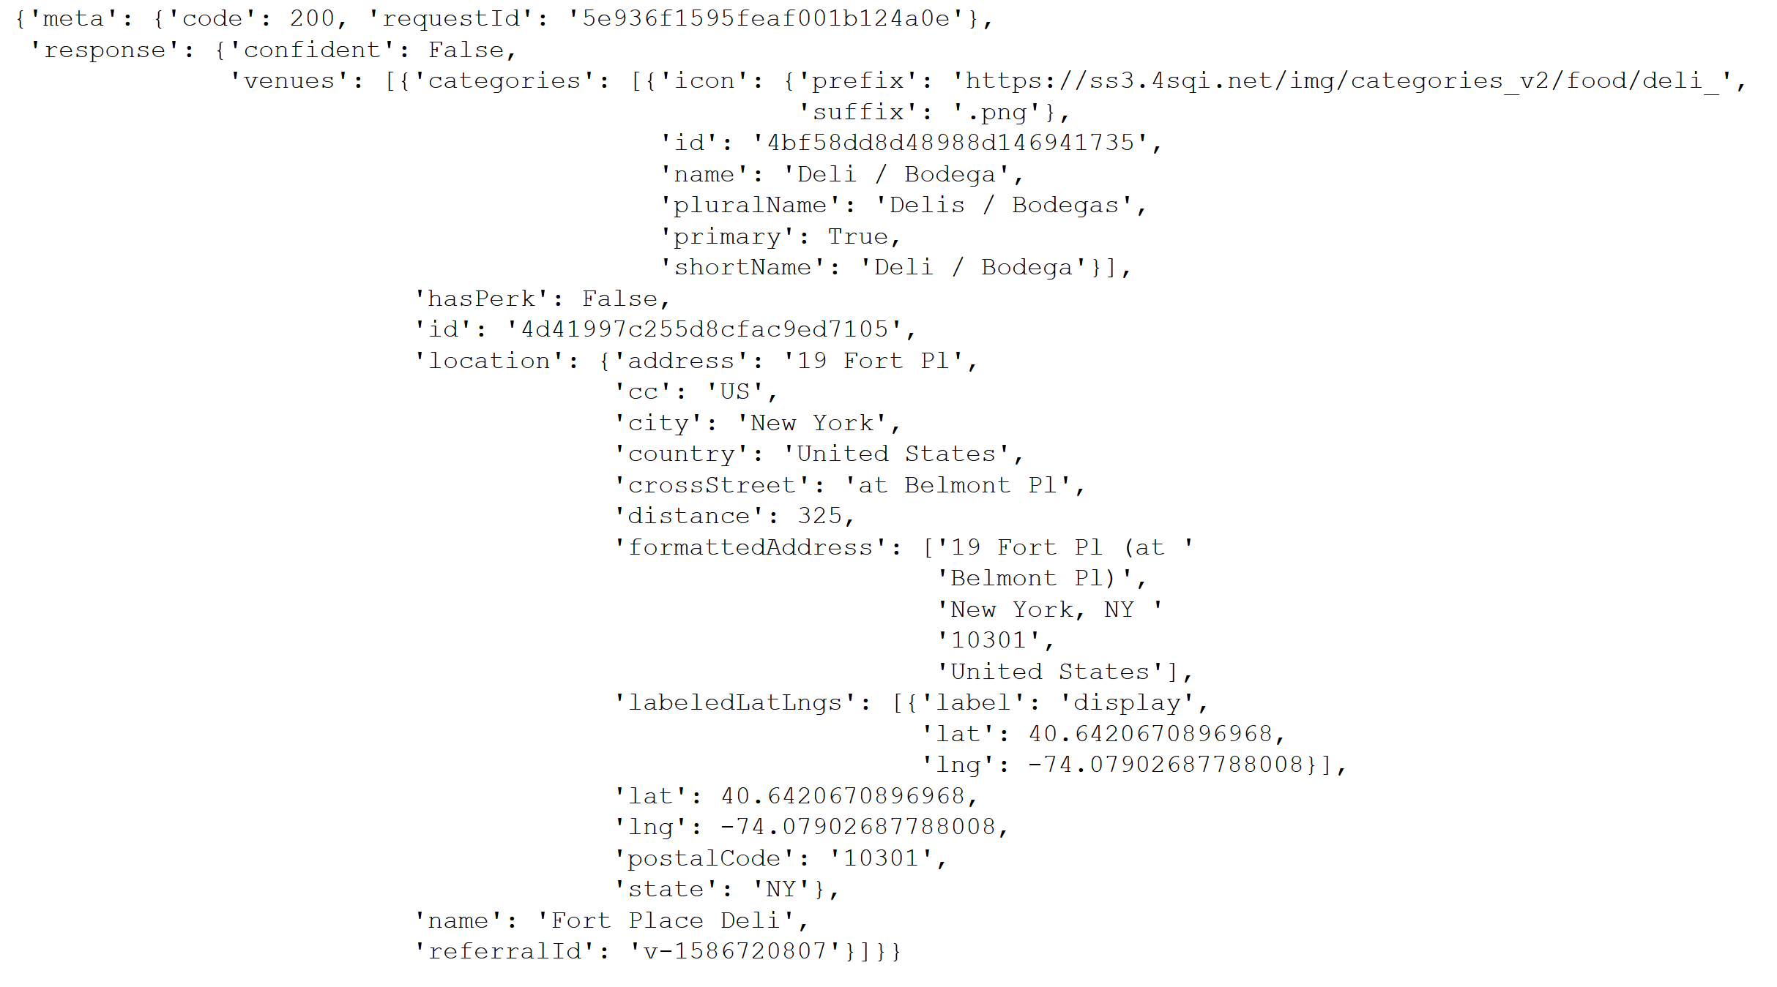
St. George neighborhood venue data within 400 m radius collected using Foursquare API

Slide 8
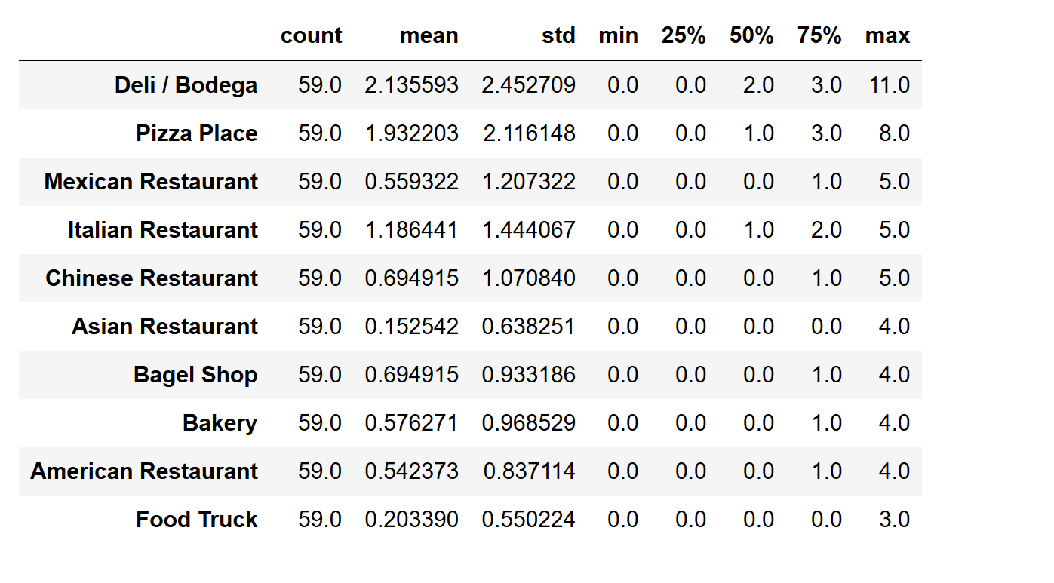
Top 10 food categories in Staten Island, NYC

Slide 9
Staten Island people are more interested in deli/bodega. But pizza places are close second and Italian restaurants are also at top which indicates that Staten Island residents are more leaned towards Italian food.
To understand further these top ten restaurants are plotted on bar graph using seaborn python library and plotted with restaurants on x axis and neighborhoods on Y axis.

Slide 10
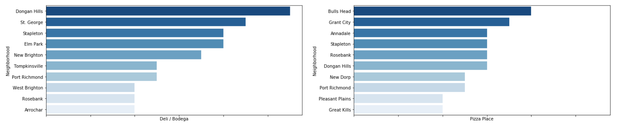
Bar graph of top 10 food categories in Staten Island, NYC

Slide 11
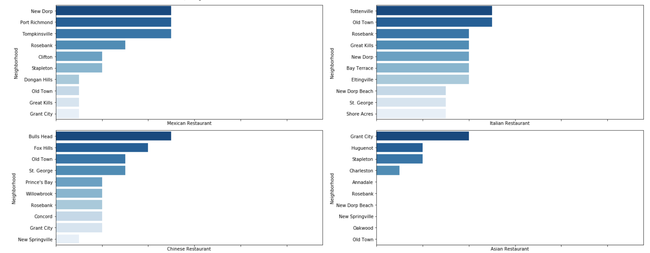

Slide 12
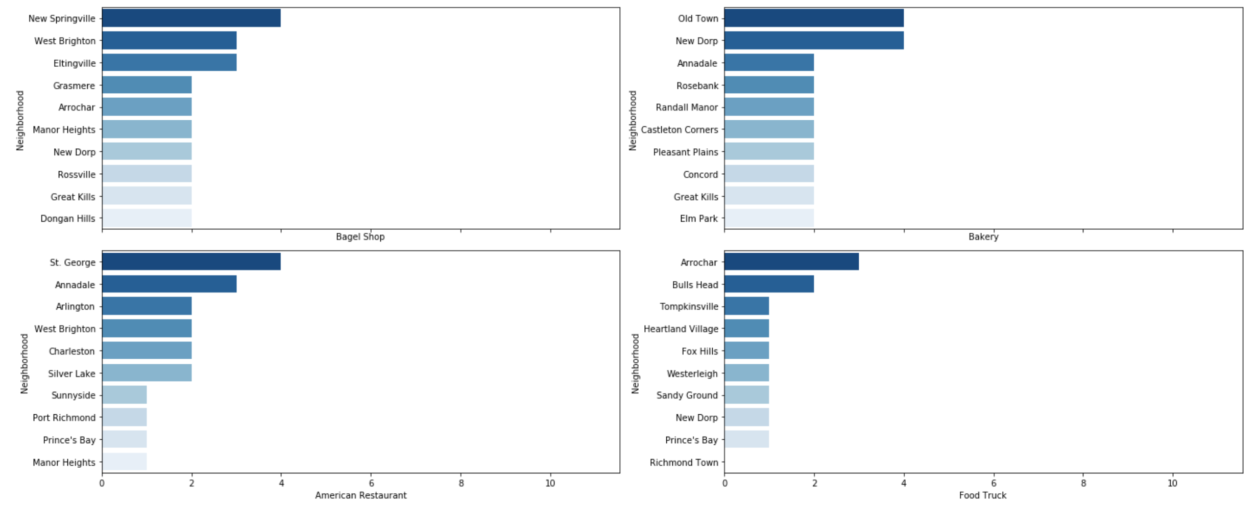

Slide 13
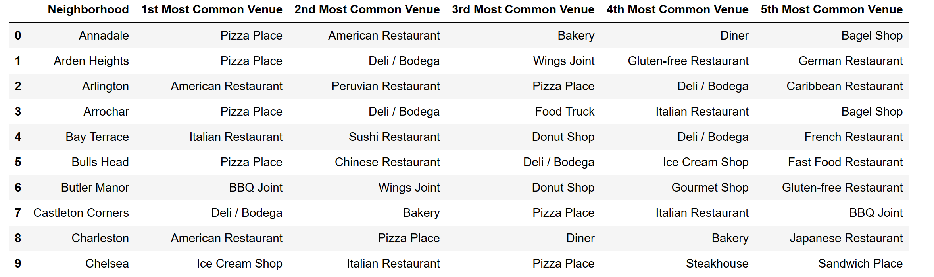
data frame sample with the top 5 venues for each neighborhood

Slide 14
Cluster Neighborhoods
Machine learning
k-means’ is an unsupervised machine learning algorithm which creates clusters of data points aggregated together because of certain similarities. This algorithm will be used to count neighborhoods for each cluster label for variable cluster size.
To implement this algorithm, it is very important to determine the optimal number of clusters (i.e. k). There are 2 most popular methods for the same, namely ‘The Elbow Method’ and ‘The Silhouette Method’

Slide 15
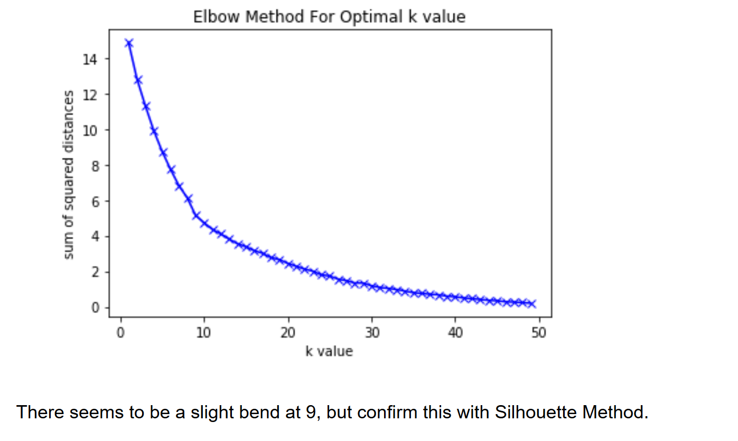
Elbow Method

Slide 16
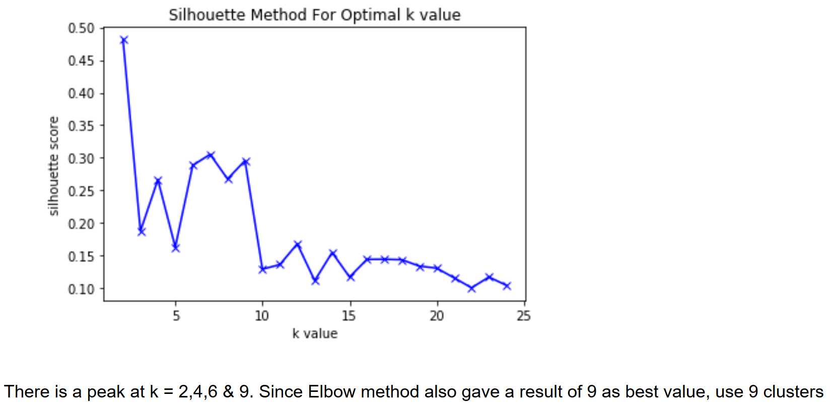
Silhouette Method
This measures how similar a point is to its own cluster compared to other clusters. It requires minimum 2 clusters to define dissimilarity number of clusters, values from 2 to 24 are used here.

Slide 17
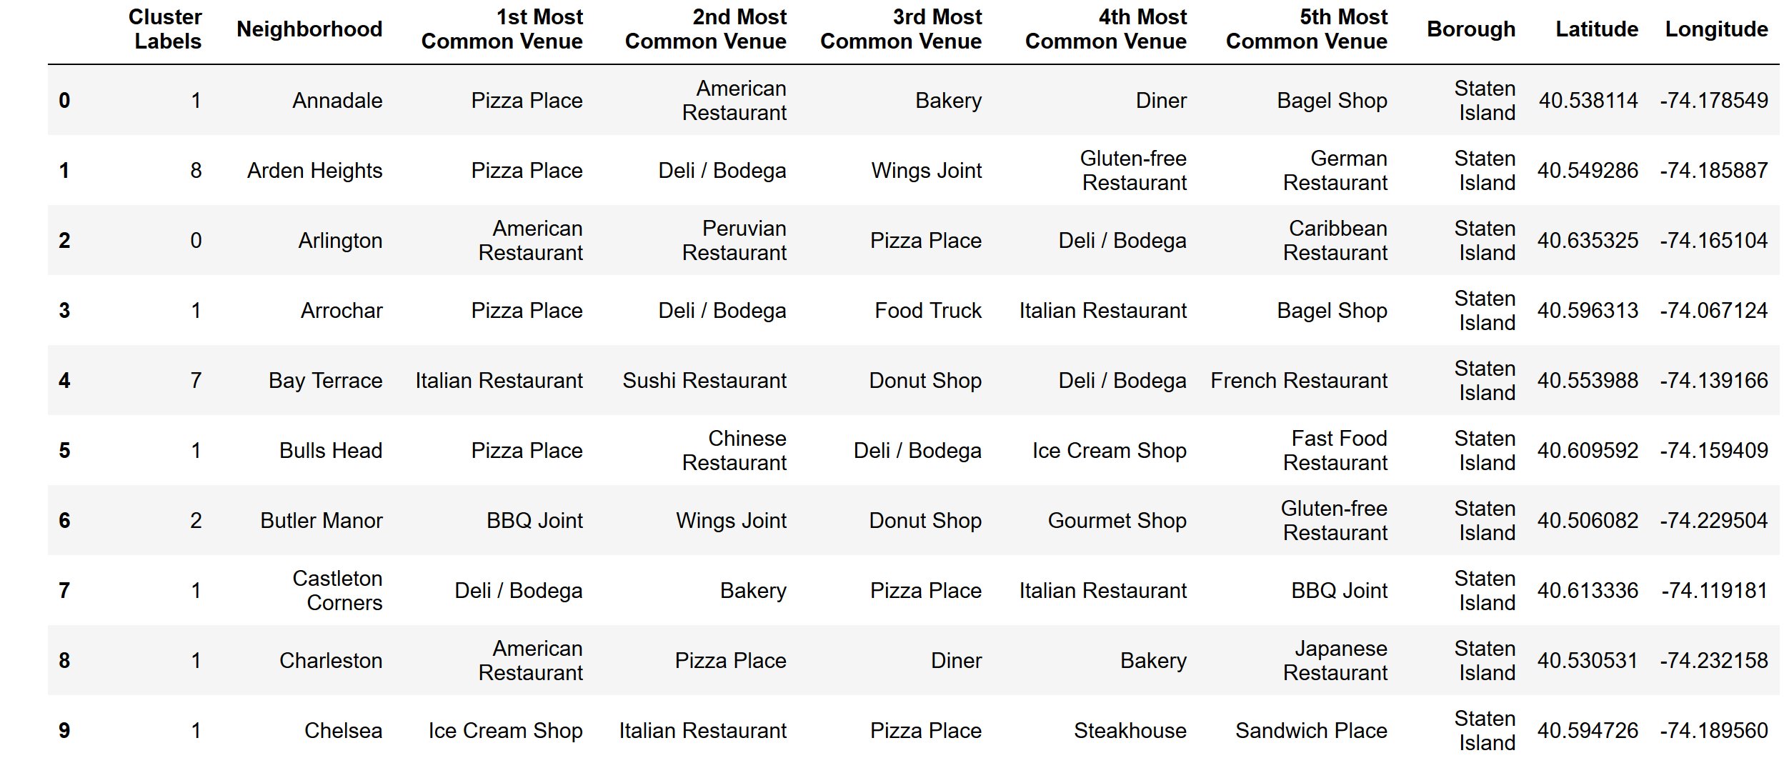
Sample data of Staten Island neighborhoods with their clusters

Slide 18
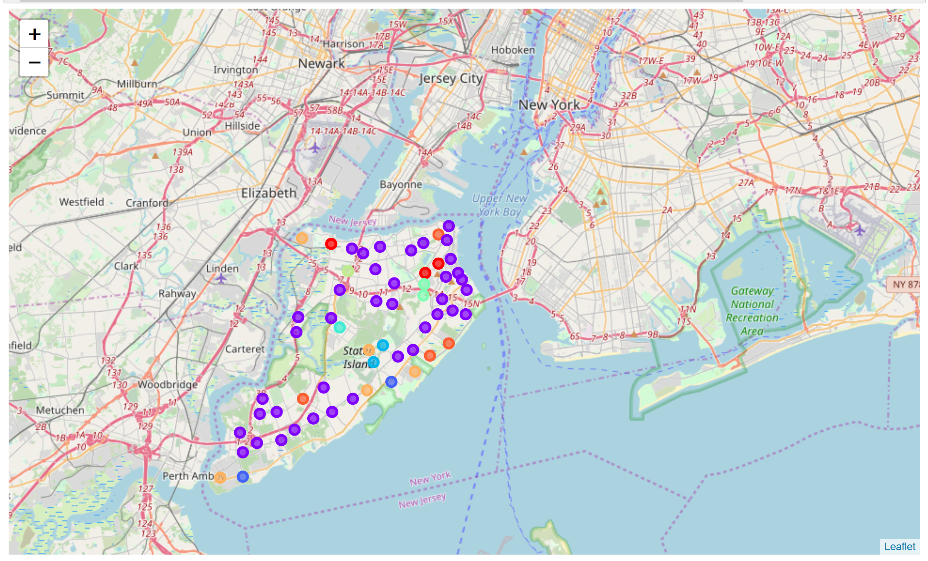
Visualize the resulting clusters with map of New York City

Slide 19
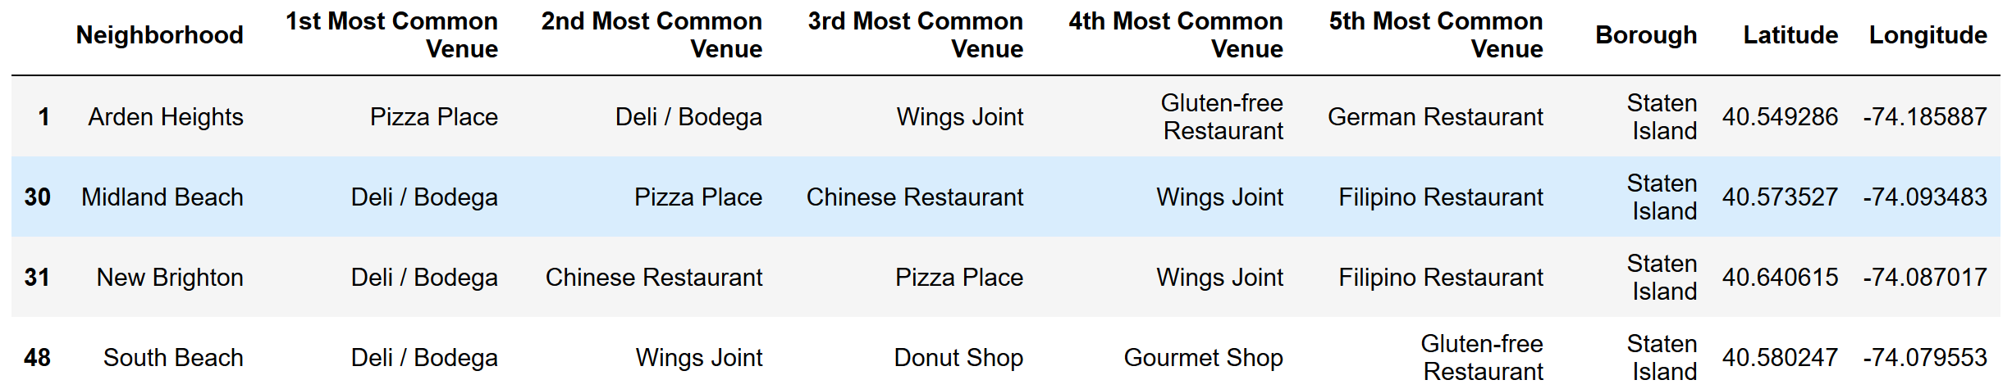
Cluster 0
Cluster 0 is dominated by deli/bodega with pizza place in second spot.

Slide 20
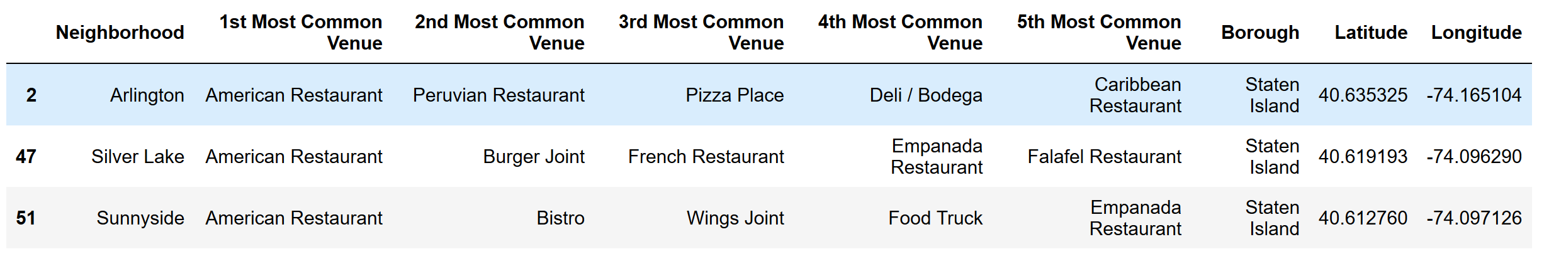
Cluster 1
Cluster 1 is clearly dominated by American Restaurants

Slide 21
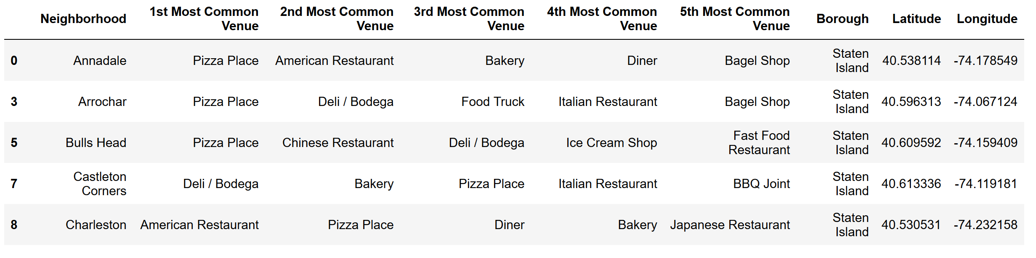
Cluster 2
Cluster 2 is dominated by pizza and deli/bodega by far, which is clear indication that residents of these neighborhoods are Italian cusine fans
Sample data is shown below

Slide 22
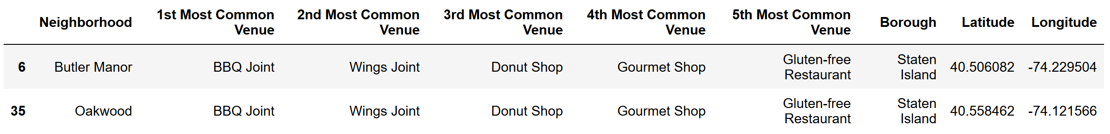
Cluster 3
Cluster 3 is dominated by BBQ and wings which is an indication that these residents like pure meat that fancy restaurants. It might also indicate that these residents are medium income resources.

Slide 23
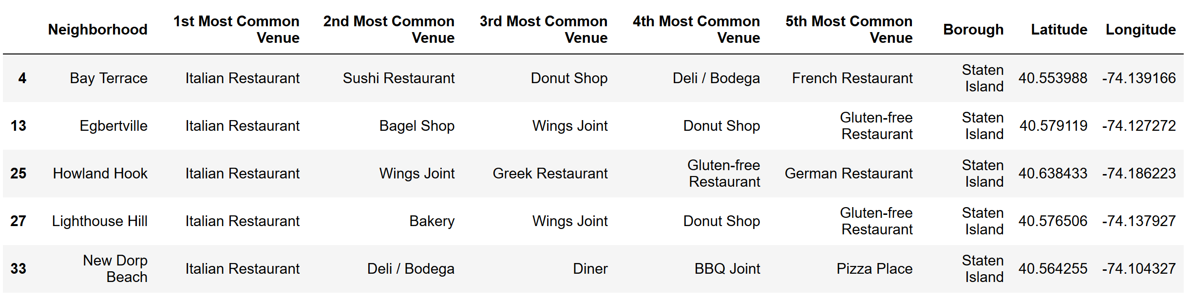
Cluster 4
Cluster 4 again is clearly dominated by Italian restaurants giving an impression that Staten Island residents are Italian food fans.
Sample data is shown below

Slide 24
Cluster 5
Cluster 5 has only one neighborhood with bagel shop as most common restaurant making it unique with wings joint in second place.

Slide 25
Cluster 6
Cluster 6 also has only one neighborhood with Sandwich place as most common venue and wings joint as second most common place.

Slide 26
Cluster 7
Cluster 7 has one neighborhood Emerson Hill with Bistro as most common place and yet again Wings joint as second most common.

Slide 27
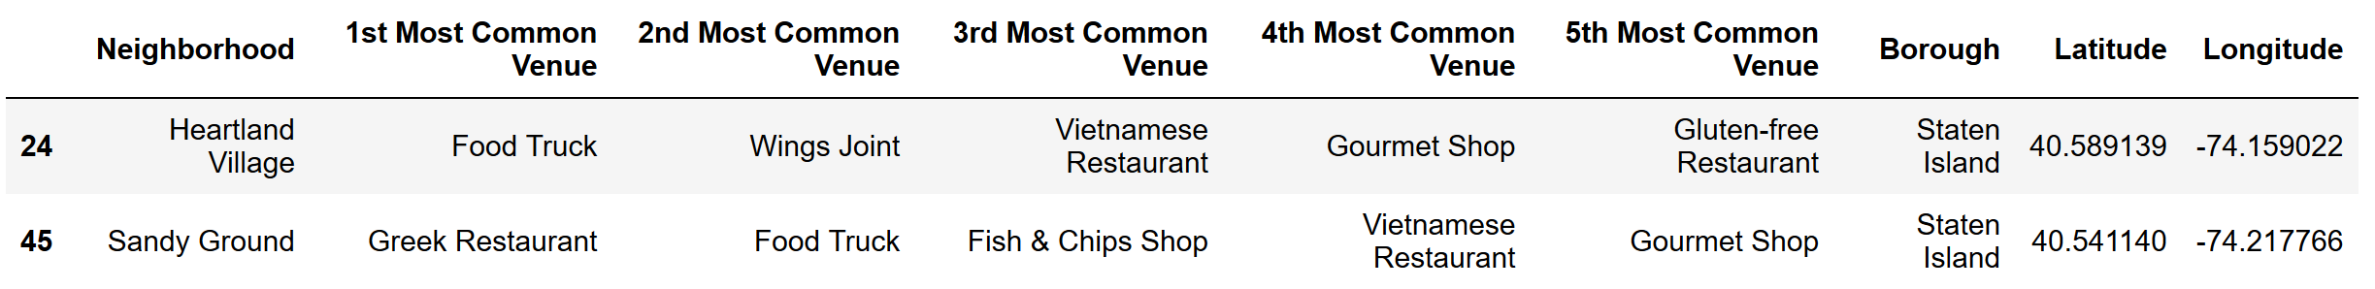
Cluster 8
Cluster 8 is dominated by food trucks by being first and second most common venues of the two neighborhoods.

Slide 28
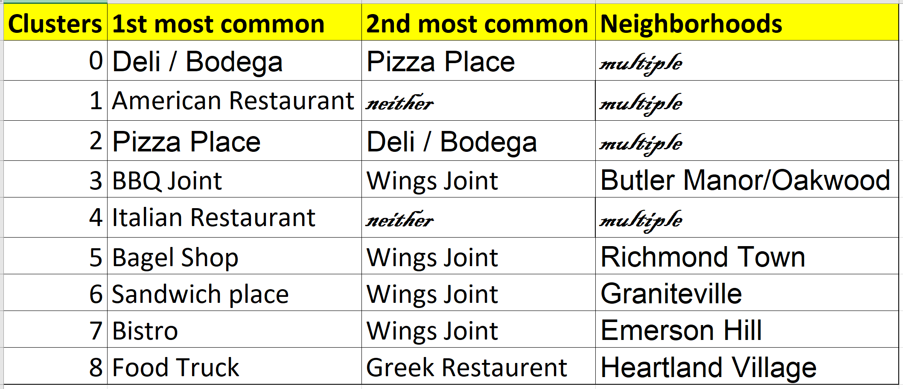
Discussion

Slide 29
Discussion … contd.
With our analysis, there are two ways to identify a neighborhood for new restaurant.
Choosing a cuisine which is most famous in Staten Island and the neighborhoods where more of the same restaurants exist because this is an indication that residents of these neighborhoods are fonder of a specific cuisine and likely to accept a new restaurant which serves better food.
If this option is chosen, pizza place, Italian restaurant, deli/bodega and American restaurants are options upscale restaurants and BBQ joint or Wings joint are options for mid to low end restaurants. Suitable neighborhoods for these cuisines can be found using above clusters and data frame.

Slide 30
Discussion … contd.
2. Choosing a cuisine which is not common in a neighborhood is another option giving opportunity to serve food which is not available at many restaurants. An example could be South Indian restaurant or Punjabi restaurant.
A caution of advice for the second option is to not open a high end restaurant in neighborhood which are dominated by wings joint because residents of these neighborhoods might not be able to afford a high end restaurant. This will be cleared when this analysis is taken further by adding mean household income and other factors of neighborhoods.

Slide 31
Conclusion
New York City neighborhoods location data was used to filter out Staten Island neighborhoods, Foursquare API was used to find venues within a radius of 400 m, data was cleaned by removing general venues such as cafe, bar and top 10 restaurants and their neighborhood locations were identified and plotted.
Further to this k-means algorithm was used to cluster the Staten Island neighborhoods into 9 different clusters and their first & second most common restaurants along with neighborhoods were identified and plotted.
Two options were provided to setup new restaurant in Staten Island. This can be taken further by using New York City local housing and demographic trends using https://furmancenter.org/neighborhoods and/or NYC planning population fact finder https://popfactfinder.planning.nyc.gov/#13.44/40.77473/-73.96117 and real estate database https://www.zillow.com/ or walkability services and apartment search tool https://www.walkscore.com/ to further explore NYC based on stakeholders' interest, time/budget.

